Slide 1


Technician Licensing Class
Lesson 2
presented by the
Midland Amateur Radio Club
Midland, Texas

Slide 2
Quiz
Subelements T1 & T2

Slide 3
Radio Phenomena
Subelement T3

Slide 4
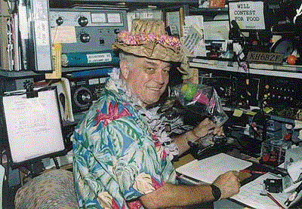
HF Propagation
It is the unpredictable nature of HF propagation that makes the HF bands so much fun!

Slide 5
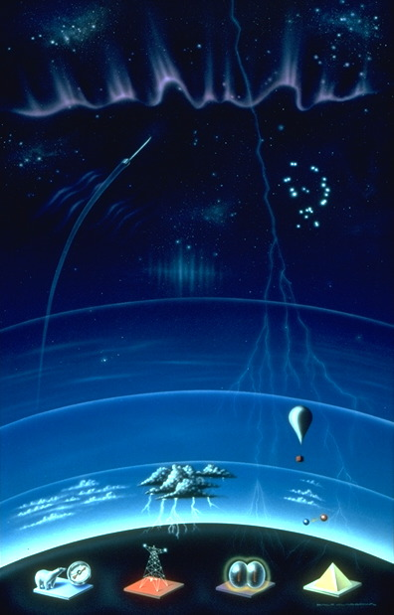
Atmospheric Layers
Ionosphere
31 – 400 miles
Stratosphere
6 – 31 miles
Troposphere
0 – 6 miles

Slide 6
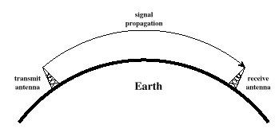
Ground-Wave Propagation
Signals travel along the surface of the earth.

Slide 7
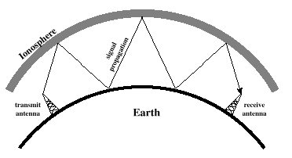
Sky-wave
Propagation
Signals are bent back to earth by the ionosphere
Multi-hop propagation has radio signals bounce several times between the ionosphere and the earth’s surface
Sky-wave propagation range is much greater than ground-wave propagation
Sky-wave propagation least often occurs in the UHF frequency range

Slide 8




How the Ionosphere is Formed
Ultraviolet and other radiation from the sun
Strikes atoms in the upper atmosphere
Releasing an electron forming positive & negative ions
-
Electron
(Negative Ion)
+
Electrically Neutral Atom
Positive Ion
Ultraviolet radiation is most responsible for ionization in the outer atmosphere.

Slide 9
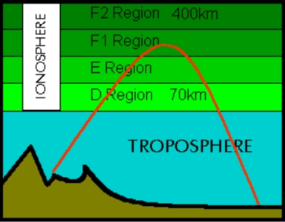
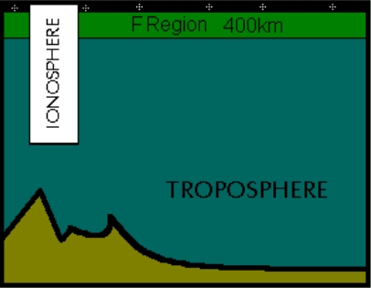
Regions in the Ionospheric
During the day....
The “D” Region is closest to Earth
The “D” Region absorbs MF/HF radio signals
The “F2” Region is most responsible for long distance communication
At night....
The “D” & “E” Regions disappear
The “F1” & “F2” Regions combine into one with reduced ionization

Slide 10
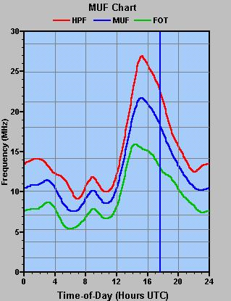
Critical & Maximum Usable Frequency
The frequency at which a signal sent vertically will pass right through the ionosphere is called the critical frequency.
The frequency at which communication just starts to fail is known as the Maximum Usable Frequency (MUF). It is generally three to five times the critical frequency, dependent upon the layer being used and the angle of incidence.

Slide 11
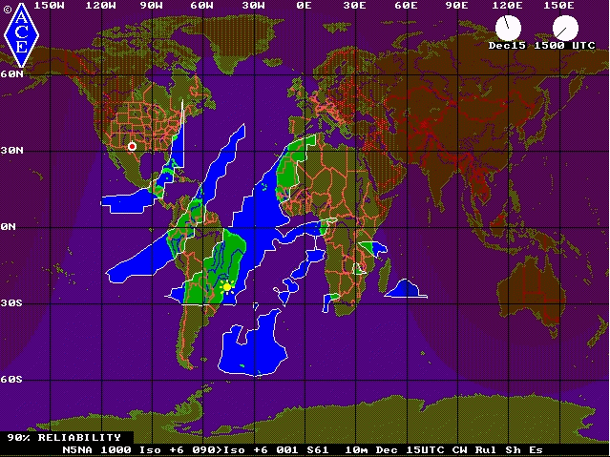
Predicted Propagation for 10m on Dec 15, 2003
Ionization is at a minimum just before sunrise.
Ionization peaks at mid-day.
Notice the prediction of multi-hop propagation.

Slide 12
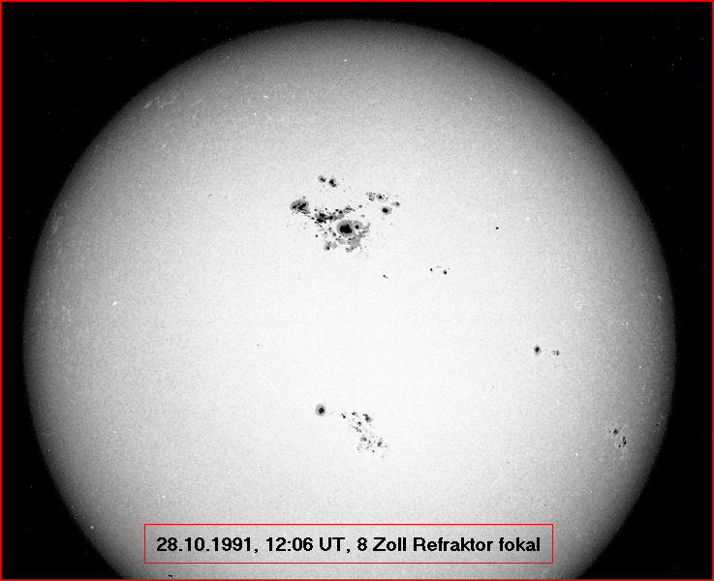
Sunspots
The more sunspots there are, the greater the atmosphere is ionized.
Thus, higher sunspot counts support a higher Maximum Usable Frequency (MUF).
Hams LOVE sunspots!

Slide 13
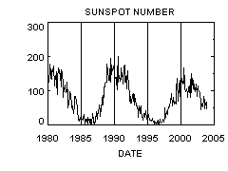
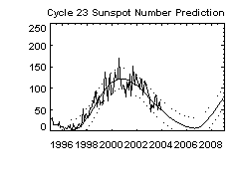
Sunspots
Sunspots peak during 11-year cycles.

Slide 14
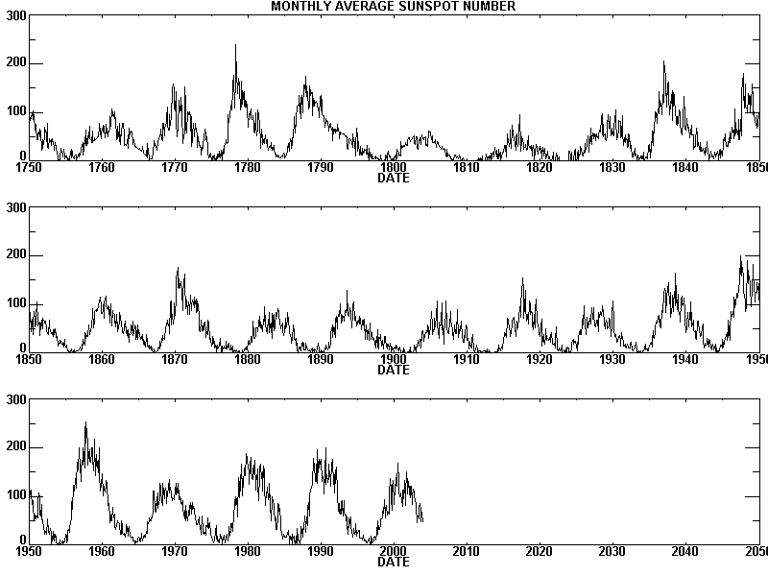

Slide 15
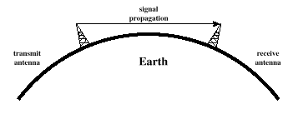
Line-of-Sight Propagation
Line of sight propagation is when radio signals travel in a straight line from one antenna to another.

Slide 16
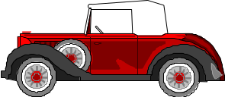
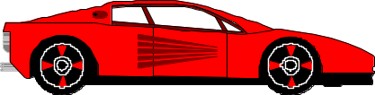
VHF/UHF Propagation
VHF / UHF signals typically travel by line of sight propagation
VHF / UHF signals can be blocked by and/or reflected off mountains and large buildings

Slide 17
Tropospheric Ducting
Warm Air
Cool Air
Tropospheric ducting may occur when a warm air mass overruns a cold air mass. This is called a temperature inversion and can produce long range VHF & UHF propagation.

Slide 18
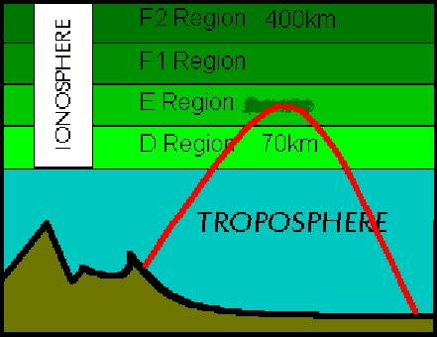
Sporadic “E” Propagation
Small areas of the “E” Region can become highly ionized
Allows long distance sky-wave propagation on the VHF bands
Most likely to occur on the 6 meter band in the summertime
By its name, it is “sporadic”

Slide 19
Station Licensee Duties
Subelement T4

Slide 20
Keep the FCC informed.....
An amateur operator must have a current U.S. postal mailing address to follow the FCC rules and receive mail from the FCC.
If your address is not correct your license could be revoked.
If you move, update your address online or fill out an FCC form 605, attach a copy of your license, and mail it to the FCC in Gettysburg

Slide 21
Where may you operate?
You may operate from anywhere in the US whenever you want.
You may operate aboard a cruise ship with the approval of the master of the ship and not using the ship's radio equipment.
You may operate aboard an aircraft with the approval of the pilot in command and not using the aircraft's radio equipment.
Wherever the location is under the control of the FCC, whenever the FCC rules allow.

Slide 22
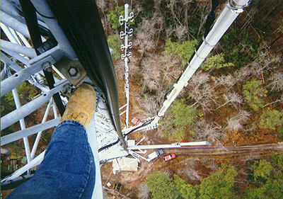
Antenna Height
You may install an antenna up to 200' without registering with the FCC & FAA
If you plan to erect an antenna exceeding 200' you must notify the FAA and register with the FCC

Slide 23
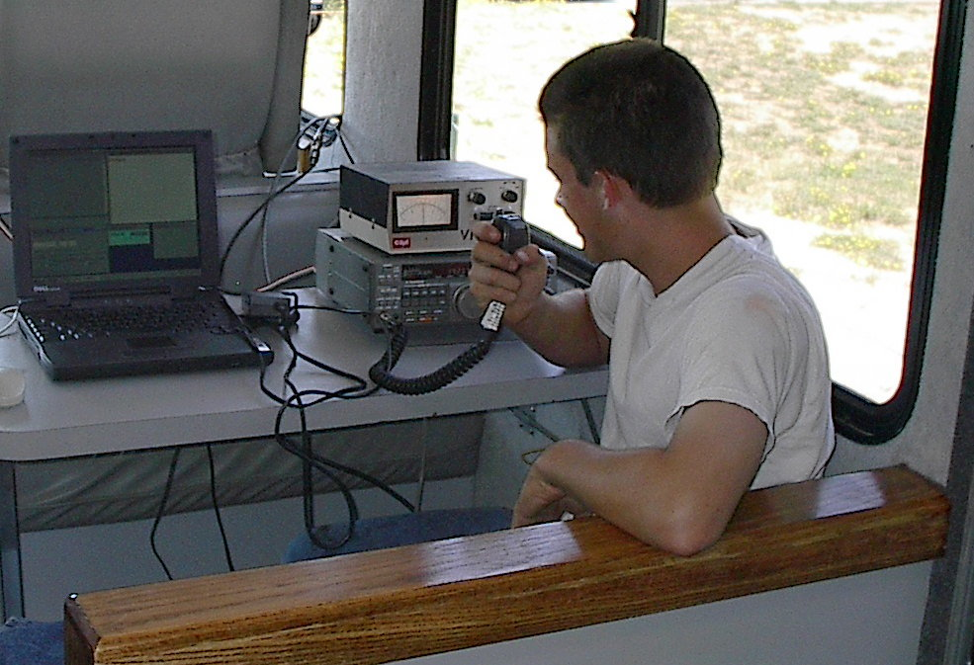
A Control Operator....
Is an amateur operator who is responsible for the station's transmissions to assure compliance with the FCC rules.

Slide 24
Control Operator Function
A station must have a control operator any time the station is transmitting.
The location where the control operator function is performed is the “control point”.
The FCC considers you in control whenever transmissions are made with your call sign.
You may be control operator for “any number” of transmitters at the same time.

Slide 25
Station Access
To keep unauthorized persons from using your station you could:
    At home – use a key-operated on/off switch in the main power line.
    In your car – Disconnect & remove the microphone when not using it.

Slide 26
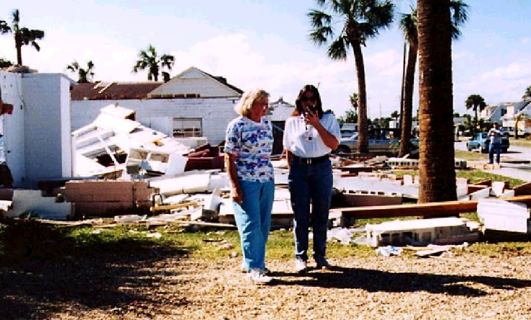
Emergency
Communications
If disaster disrupts normal communications an amateur station may make transmissions that are necessary to meet essential communication needs & facilitate relief actions
In an emergency you are allowed to help on any frequency outside your privileges in any way you can
The FCC may declare a temporary state of communication emergency and may set forth special conditions and rules to be observed

Slide 27
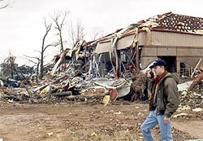
Emergency Calls
In a life or property threatening emergency you are allowed to transmit “SOS” or “MAYDAY”
If you are in contact with another station and you hear an emergency call you should stop your QSO immediately and take the emergency call
If you need to interrupt a repeater conversation for an emergency say “BREAK” once and then your call sign

Slide 28
Emergency Operations
A method of operating a station independent of commercial AC power may be a good idea for providing emergency communications
When using a hand-held radio in an emergency it is important to have several sets of charged batteries available
For HF portable operations in an emergency a dipole antenna is a good choice due to its ease of transportation and set up

Slide 29
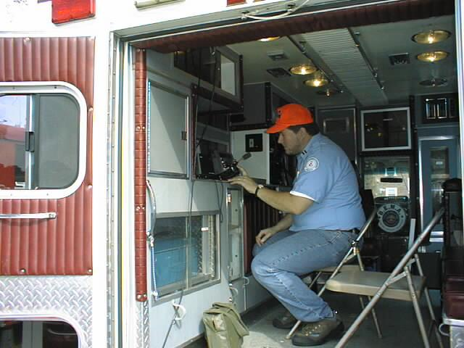
Emergency Operations (Cont'd)
The use of “tactical” call signs such as “command post” or “weather center” are efficient & help coordinate public service communications
Messages concerning the immediate safety of human life are called “Emergency Traffic”
Messages concerning a person's well being are called “Health & Welfare Traffic”

Slide 30

RACES
RACES is the Radio Amateur Civil Emergency Service
Before you can participate in RACES drills you must register with the responsible civil defense organization
Messages sent during a RACES drill must be identified as “drill” or “test messages”
RACES is not active in the Midland/Odessa area

Slide 31
Control Operator Duties
Subelement T5

Slide 32
You're the Control Operator
You must be at the control point when transmitting unless the station is under automatic control.
If you have a dual band transceiver and set it up as a cross-band repeater there must be a control operator at the control point.
You do not have to be at the control point of an automatically controlled station.
An unlicensed family member may not use your equipment if you are not present.
A detailed list of your operating privileges and rules & regs may be found in FCC Part 97.

Slide 33
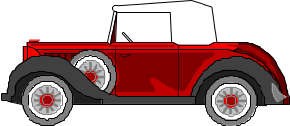
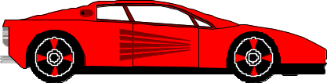
A repeater is a device used to retransmit amateur radio signals.
Offset
+ 600 kHz
Input Freq
147.90 MHz
Output Freq
147.30 MHz
60 miles

Slide 34
Operating Another Station
You may operate any amateur equipment within your license privileges.
If you are operating from another amateur's station both you and the other amateur are responsible.
When a higher license class amateur operates your station the privileges of the higher license are allowed.
When a Technician licensee operates the station of a General class licensee he must stay within the limits of a Technician class license.

Slide 35
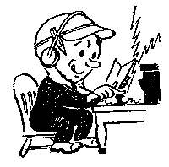
Station Identification
You must identify with your callsign at least every 10 minutes during and at the end of a contact.
If you are using a language other then English you must identify in English.
CW (morse code) may always be used for identification regardless of the transmitting frequency.
If you communicate with someone without identifying you have made an unidentified communication.

Slide 36
Don't do this!!!
Cause harmful or malicious interference by repeatedly (and intentionally) transmitting on a frequency already occupied
Perform an illegal unidentified transmission by transmitting a test to a repeater without identifying
Contact someone on the air without giving your call sign. This would be an unidentified communication.

Slide 37
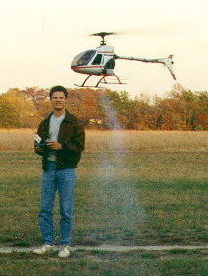
Radio Control of Model Craft
An example of one-way communication permitted by the FCC is radio control of model craft.
Station identification is not required if the transmitter is labeled with the licensee's name, address, and call sign.

Slide 38
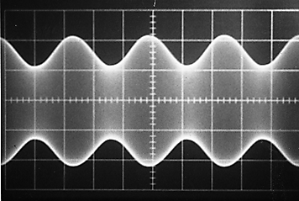
Peak Envelope Power (PEP)
Peak Envelope Power (PEP) is the average power supplied to an antenna transmission line during one RF cycle at the crest of the modulation envelope.
Amplitude
Modulation Peak
Time

Slide 39
Maximum Transmitter Power
A Technician with morse licensee may use up to 200 watts (PEP) on the 80, 40, 15, & 10 meter bands.
On most other bands, a Technician licensee may use up to 1500 watts PEP.
In all cases, use the minimum power required to make a reliable contact.

Slide 40
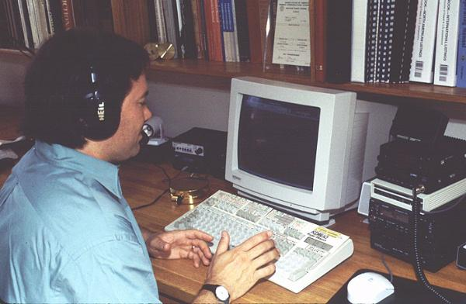
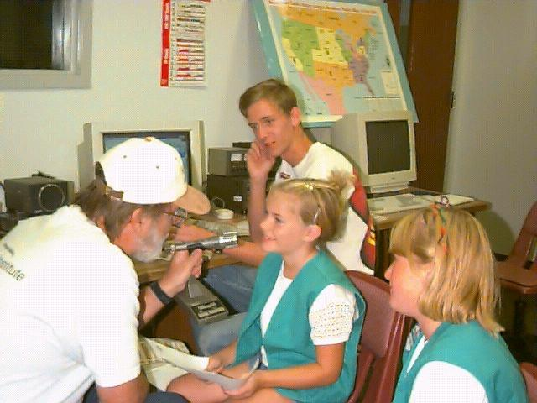
Third Party Communications
A message from an amateur station (1st party) to another amateur station (2nd party) on behalf of another person (3rd party)
Examples include:
Passing a message
Making a phone patch
Allowing an unlicensed person to talk on the radio

Slide 41
Third Party Communications
When talking to a station in a foreign country be sure there is a 3rd party agreement between the US and the other station’s country before handling 3rd party traffic.
      Some countries we have 3rd party agreements with are:
      Cuba Ecuador Columbia Panama
      Jordan Argentina Peru Turkey
      Canada Mexico Israel Ghana
  When handling international 3rd party communications the U.S. station must transmit both call signs at the end of each communication.
  No payment may be accepted for handling 3rd party communications

Slide 42
Homework
Study Subelements T3, T4, & T5 of the question pool.
  Read the Question and the Answer Three Times.
Read Chapters 3, 4, & 5 in “Now You're Talking”.

