Slide 1


Technician Licensing Class
Lesson 3
presented by the
Midland Amateur Radio Club
Midland, Texas

Slide 2
Quiz
Subelements T3, T4, & T5

Slide 3
Good Operating Practices
Subelement T6

Slide 4
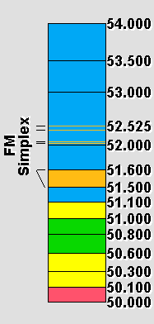
A Band Plan is a voluntary guideline for using different operating modes within an amateur band.
50.000-50.100: CW - No voice modes allowed per FCC section §97.305
50.060-50.080: CW/Beacon Subband
50.100-50.300: Phone (SSB), etc. (no FM voice)
50.100-50.125: DX Window
50.300-50.600: All modes (simplex)
50.600-50.800: Digital modes (e.g. Packet)
50.800-51.000: Radio Control (R/C)
51.000-51.100: "Pacific DX window" (SSB/CW)
51.120-51.480: 6 Meter FM Repeater Inputs (areas w/500 KHz split)
51.500-51.600: Simplex FM, 6 channels: 51.500, 51.520, 51.540, 51.560, 51.580, and 51.600
51.620-51.980: 6 Meter FM Repeater Outputs (areas w/500 KHz split)
52.000-52.480: 6 Meter FM Repeater Inputs (for 500 KHz and 1 MHz split)
  Note: 52.525, 52.400, 52.040, and 52.020 are widely used for simplex operation with 52.525 being the "national simplex" frequency.
52.500-52.980: 6 Meter FM Repeater Outputs
53.000-53.480: 6 Meter FM Repeater Inputs and Repeater Outputs
53.500-53.980: 6 Meter FM Repeater Outputs

Slide 5
Before you transmit.....
Always LISTEN first!
  If you don't hear anyone give a short call to ask if the frequency is in use (usually only on HF)
  “Is this frequency in use? This is YOURCALL”

Slide 6
Initiating a Contact – HF Bands
“CQ” means “Calling Any Station”
  Voice - “CQ CQ CQ this is N5NA N5NA N5NA”
  Morse Code - “CQ CQ CQ DE N5NA N5NA N5NA”
    “DE” means “from” or “this is” in morse code
    Send at a speed you can reliably copy
Answer a CQ
  Voice - Say the other station's call once, followed by “this is”, then your call phonetically
  Morse Code – Send the other station's call twice, “DE”, then your call twice

Slide 7
Initiating a Contact – VHF/UHF FM
If you know the other station's call sign...
  Say the station's call sign, then your call sign
  “K5RS...N5NA” or “K5RS this is N5NA”
If you don't know a station to call....
  Say “This is YOURCALL monitoring”

Slide 8
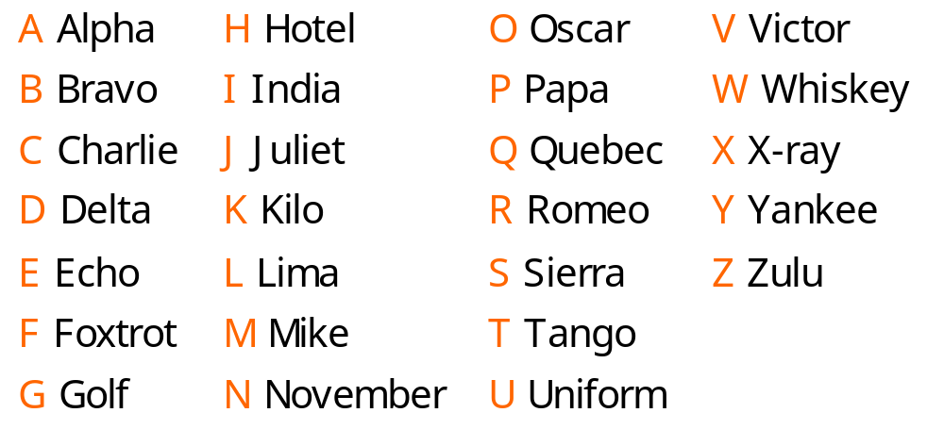
ITU Phonetic Alphabet

Slide 9
ITU Phonetic Alphabet
Used for accurate copy when band conditions are noisy or crowded.
Words are internationally recognized substitutes for letters.
Avoid cute phrases as they are not easily understood by non-English speaking amateurs.
Generally not needed on repeaters.

Slide 10
Ham “lingo” you may hear.....
“73” means “Best Regards”
“DX” means “Distant Station”
“K” means “Any Station Transmit” – used on morse code
“QRS?” means “Send More Slowly” - used on morse code
“Your signal is full quieting...” means your signal is strong enough to overcome all receiver noise – used on FM

Slide 11
The RST Reporting System
The RST system is a quick way amateurs use to describe a received signal.
Readability 1 = Poor 5 = Good
Signal Strength 1 = Poor 9 = Good
Tone (CW only) 1 = Poor 9 = Good
Note: Do not use the RST system on repeaters.

Slide 12
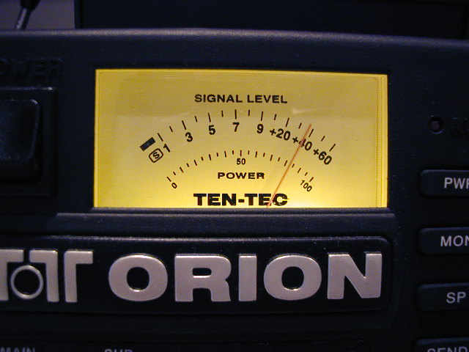
S - Meter
The S - meter gives
a relative signal strength
reading of a received
signal.
A report of “five nine plus
20 db...” means the signal
strength reading is 20
decibels greater than
strength 9

Slide 13

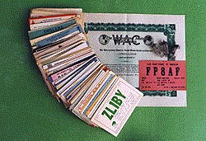


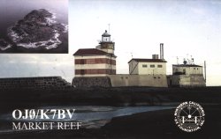

QSL Cards
A QSL card is a written acknowledgement of
communications between two amateurs.

Slide 14


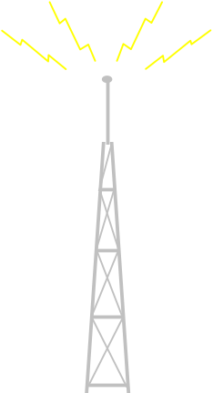
An amateur radio station used to connect other amateur radio stations to the internet is called a gateway.
PC User
Internet
Gateway
Repeater
Gateway
Repeater

Slide 15
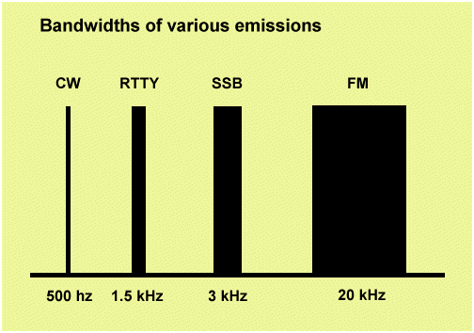
Bandwidth
SSB Signal 2 - 3 kHz wide
FM Signal 10 - 20 kHz wide
UHF Fast-Scan TV ~ 6 MHz

Slide 16
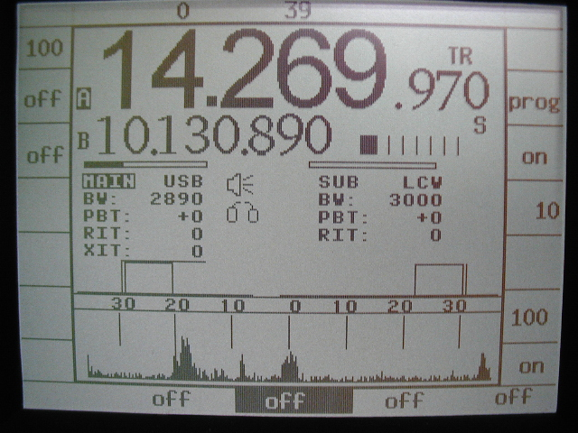
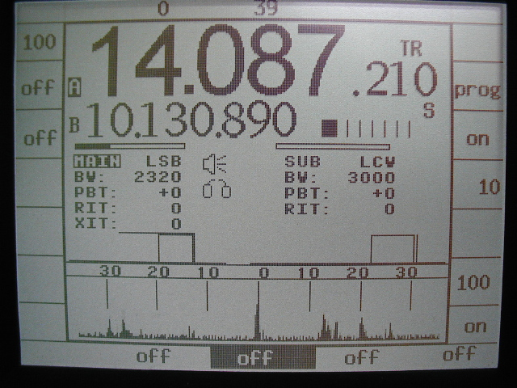
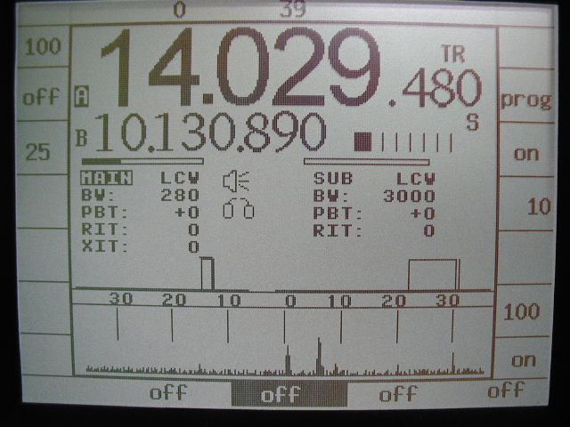
Bandwidth
SSB Signal
RTTY Signal
CW Signal

Slide 17
Harmonic Interference
Transmitters can generate harmonics that can interfere with other amateurs or other radio services.
The FCC regulations specify limits for harmonic radiation.
You are responsible for ensuring your transmitter does not produce harmonic radiation.
Desired Frequency
2nd Harmonic
3rd Harmonic
4th Harmonic
50.25
100.50
150.75
210.00
Frequency (MHz)

Slide 18
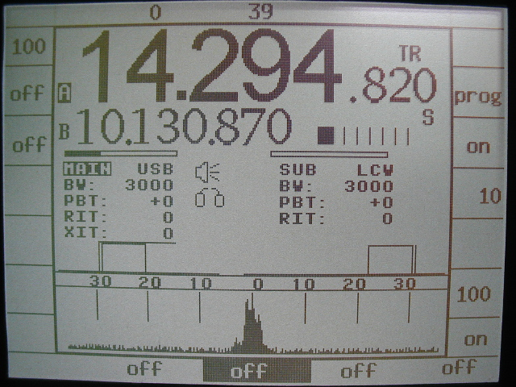
Splatter Interference
On SSB, if the mic gain is set too high it may cause “splatter” interference.

Slide 19

TV Interference
If you are told your station is causing TV interference, check if it is causing interference to your own TV.
If harmonic radiation from your transmitter is causing interference to a TV, you are responsible for taking care of the problem.

Slide 20
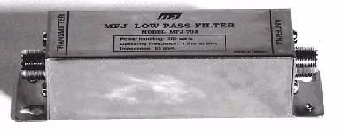
Low-Pass Filter
A low-pass filter
goes between your
transmitter and
antenna. It removes
harmonic radiation
from your signals.

Slide 21
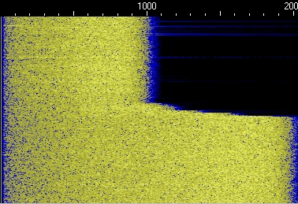
Low-Pass Filter
A low-pass filter
blocks RF energy
above a certain
limit.
Low Pass Filter Switched In
No Filter

Slide 22

TV Interference
Receiver overload is caused by nearby strong radio signals.
If your transmitter is causing front-end overload of a TV, the owner of the TV is responsible of taking care of the problem.
A break in a cable TV line may allow TV interference when the amateur station is transmitting or may cause interference to the amateur station.

Slide 23
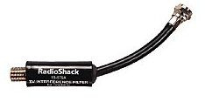
High-Pass Filter
A high-pass filter goes
between a TV and
antenna.
It is the first step in trying
to prevent RF overload
from an amateur HF
station transmission.

Slide 24
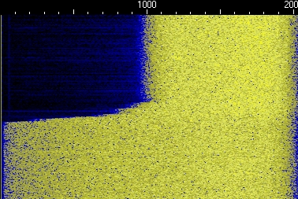
High-Pass Filter
A high-pass filter blocks
RF energy below a
certain limit.
High Pass Filter Switched In
No Filter

Slide 25
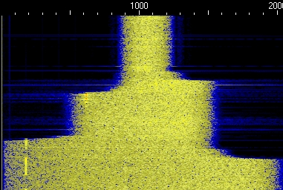
Band Pass Filter
A band-pass filter blocks RF energy above and below certain limits.
A band-pass filter may be used to block interference from a strong transmitter on a frequency near your operating frequency.
Band Pass Filter Switched In
No Filter

Slide 26
Other Interference / Signal Problems
Many telephones are not equipped with interference protection and may receive strong radio signals.
Spurious radiation from a hand-held transceiver could interfere with other signals on a frequency near yours.
A bad filter capacitor in a power supply can cause buzzing or hum on a transmitted signal.

Slide 27
Basic Communications Electronics
Subelement T7

Slide 28
System of Metric Units
giga G 10⁹ 1,000,000,000
mega M 10⁶ 1,000,000
kilo K 10³ 1,000
basic unit 10⁰ 1
milli m 10⁻³ 0.001
micro u 10⁻⁶ 0.000001
pico p 10⁻¹² 0.000000000001

Slide 29
Unit Conversion Practice
1 kilohertz = ??? hertz
1000 hertz
3.525 MHz = ???? kHz
3525 kHz
1,000,000 picofarads = ? microfarads
1 microfarad
500 milliwatts = ? watts
0.5 watts
3000 milliamperes = ? amperes
3 amperes

Slide 30
Voltage & Current
Current is the flow of electrons in an electric circuit.
  Current can be compared to the flow of water in a pipe.
  The basic unit of current is the ampere.
Electromotive Force or Voltage is the force that pushes the electrons thru the circuit.
  Voltage can be compared to pressure that pushes water thru a pipe.
  The basic unit of voltage is the volt.

Slide 31
Conductors
Materials that allow the flow of electrons are called conductors. Some good conductors are:
    Gold
    Silver
    Aluminum
    Copper
    Most metals

Slide 32
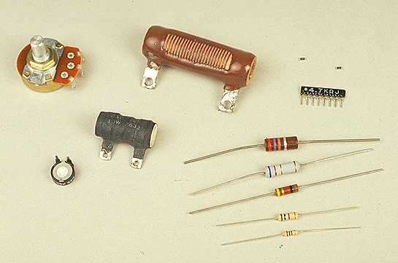
Resistance
Resistance opposes the flow of electrons in a material.
Resistance limits the current that can flow thru a circuit.
Resistance can be compared to a restriction in a water pipe.
The ohm is the basic unit of resistance.
Fixed-value resistor
Variable resistor or potentiometer

Slide 33
Adding Resistors
The total resistance of two
resistors in series is the
sum of their individual
values.
R_{t} = R1 + R2
The total resistance of two resistors in parallel is the product over the sum.
R_{t} = R1 x R2
R1 + R2

Slide 34
Voltage and Current?
+
I
R
E
-
A
It is possible to have voltage without current, as in
the case of a battery by itself. In order to have current, there must be an electrical path (circuit) from the positive to the negative terminal of the voltage source.

Slide 35
Ohms Law
Ohms Law is a formula that shows the relationship between Voltage (E), Current (I), and Resistance (R).
    E = I x R
Ohms Law is applicable to all electrical circuits.

Slide 36
Ohms Law
Electromotive Force, VOLTS
E
I
R
The flow of
electrons
AMPERES
Resistance
to current flow
OHMS

Slide 37
Ohms Law Excercise
+
200 volts
100 ohms
_
A
What is the current through the resistor?
E
E
I = E / R = 200 / 100 = 2 amperes
I
R

Slide 38
Ohms Law Excercise
+
?? volts
2 amperes
50 ohms
_
A
What is the voltage across the resistor?
E
E
E = I x R = 2 x 50 = 100 volts
I
R

Slide 39
Ohms Law Excercise
+
90 volts
3 amperes
?? ohms
_
A
What is the value of the resistance in the circuit?
E
E
R = E / I = 90 / 3 = 30 ohms
I
R

Slide 40
Decibel (dB)
The decibel is a comparison of power levels. It is defined as:
10 x log (P2/P1)
For example: P1 = 5 w and P2 = 10 w
P2 / P1 = 10 / 5 = 2
log 2 = 0.3
10 x 0.3 = 3 dB
Just remember – Every 3 dB increase is the same as doubling the power and every 3 dB decrease is the same as halving the power.

Slide 41
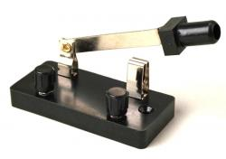
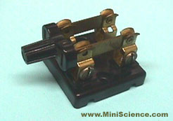
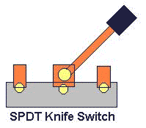
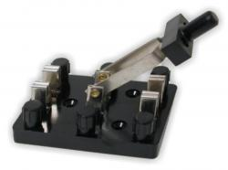
Switches
Single Pole Single Throw (SPST)
Double Pole Single Throw (DPST)
Single Pole Double Throw (SPDT)
Double Pole Double Throw (DPDT)

Slide 42
Diodes
V+
0
Resistor
V-
Adding a diode allows current to flow in only one direction.
Diode
V+
0
Resistor
V-
The diode changes the alternating current into varying direct current. This circuit is called a rectifier.

Slide 43
Transistors
Transistors amplify signals using low voltages and currents.
This is a PNP transistor.
Base
Collector
Emitter

Slide 44
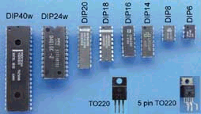
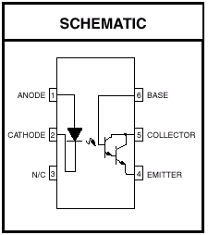
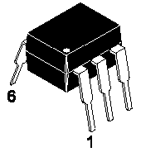
Integrated Circuits (IC's)
An IC (Integrated Circuit) combines several functions into one package.

Slide 45
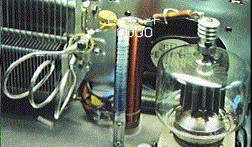
Vacuum Tubes
Vacuum tubes can amplify small signals but use high voltages.

Slide 46
Inductors
Anytime current flows through a conductor, a magnetic field is created around that conductor.
If the conductor is formed into a coil shape, the strength of the magnetic field is intensified.
When the switch is closed, current flows through the inductor, building a magnetic field.
When the switch is opened, the field collapses, inducing a current in the inductor.
An inductor stores energy electromagnetically and opposes a change in current.
The unit of measure is the Henry.

Slide 47
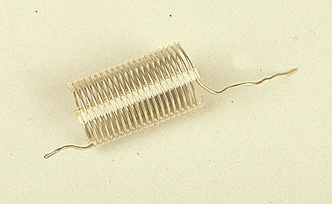
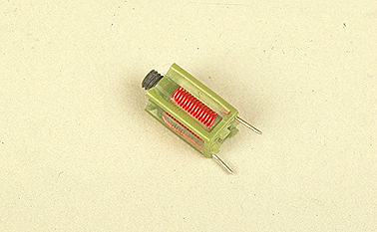
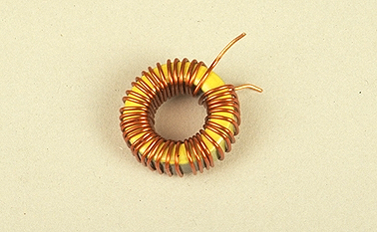
Inductors
Air Core
Variable
Iron Core

Slide 48
Capacitors
A capacitor is made by separating two conductive plates by an insulator or dielectric.
Capacitors store energy electrostatically.
Capacitors tend to block DC and pass AC.

Slide 49
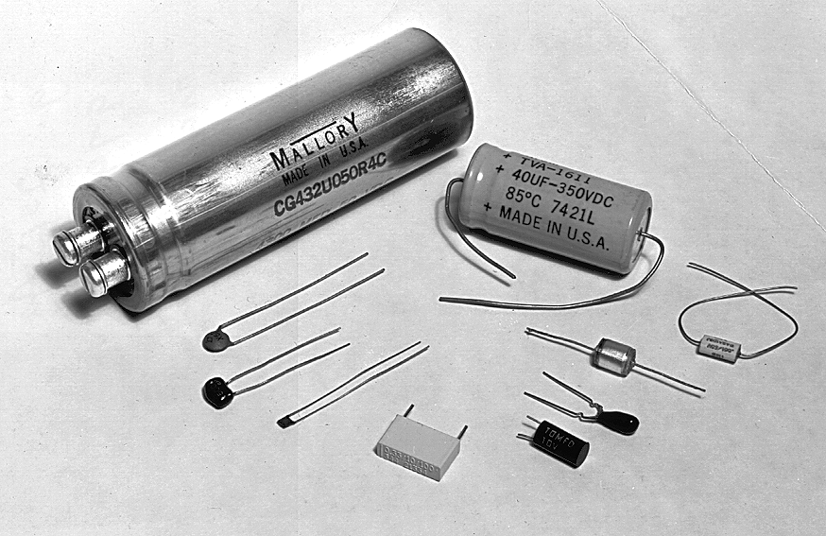
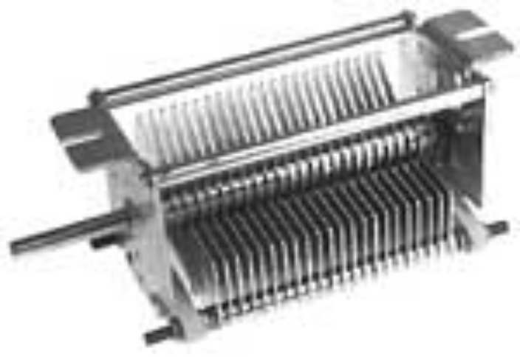
Capacitors
Fixed Value Capacitors
Variable Capacitor
Consists of two sets of rotating conducting plates separated by an insulator, which can be varied in surface area exposed to each other

Slide 50
Adding Capacitors
The total capacitance of
capacitors connected in
parallel is the sum of the
values of the capacitors.
C_{t} = C1 + C2
If the capacitor values are
equal the total capacitance
is twice the value of one
capacitor.

Slide 51
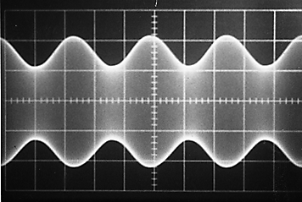
Analog Signals
Analog signals have voltage or current values that vary continuously over some range.
Amplitude Modulation (AM) and Frequency Modulation (FM) are examples of Analog modes.
AM
FM

Slide 52


Digital Signals
Digital signals have voltage or current values only in specific steps over a certain range. Typically on or off.
Radio Teletype (RTTY) and Morse Code (CW) are examples of Digital modes.

Slide 53
Schematic Symbols You Need to Know
Fixed-value iron-core inductor
Single-cell battery
NPN transistor
Fixed-value resistor
Variable resistor or potentiometer
Single-pole, double-throw switch
Double-pole, single-throw switch
Fixed-value capacitor
Antenna

Slide 54
Homework
Study Subelements T6 & T7 of the question pool.
  Read the Question and the Answer Three Times.
Read Chapters 6 & 7 in “Now You're Talking”.

