Slide 1


Technician Licensing Class
Lesson 4
presented by the
Midland Amateur Radio Club
Midland, Texas

Slide 2
Quiz
Subelements T6 & T7

Slide 3
Good Engineering Practice
Subelement T8

Slide 4
A Basic Station
Antenna
Feed Line
Transmitter
T-R
Switch
Receiver
Power Supply

Slide 5
Simple CW Transmitter
Antenna
POWER AMPLIFIER
1
DRIVER
TELEGRAPH KEY
Block 1 controls the frequency of the transmitter
  If Block 1 is a crystal it is referred to as a “crystal controlled transmitter”
  If Block 1 is a variable-frequency oscillator it is referred to as a “VFO controlled transmitter”
CW is transmitted by on/off keying of the RF signal with the telegraph key.

Slide 6
Frequency Modulation (FM)
Unmodulated carrier, full power
at all times
Waveform of modulating signal
Modulated carrier with frequency
deviation and constant amplitude

Slide 7
FM Transmitter
AUDIO AMP
CLIPPER
FILTER
BLOCK 1
MULTIPLIER
MIC
OSCILLATOR
MULTIPLIER
MULTIPLIER
POWER AMP
In an FM transmitter, Block 1 represents a Reactance Modulator.
The Reactance Modulator changes the phase or frequency of the oscillator in response to the audio input.

Slide 8
FM Transmitter
AUDIO AMP
CLIPPER
FILTER
REACTANCE MODULATOR
MULTIPLIER
MIC
OSCILLATOR
MULTIPLIER
MULTIPLIER
POWER AMP
If the Audio Amplifier in this FM transmitter failed the output would be an unmodulated carrier.

Slide 9
Frequency Modulation
FM transmitters operate at full power at all times, even with no audio input.
When an FM transmitter over-modulates, the transmitted signal becomes so wide (bandwidth) it may cause out-of-channel emissions and interfere with adjacent channels. This is called over-deviation.
If you are told you are over deviating you can talk farther away from the microphone.
FM is effective for local VHF/UHF communications because the audio is less affected by static-type electrical noise.

Slide 10
Simple CW & SSB Receiver
Product Detector
Intermediate Frequency Amplifier
Audio Amplifier
Mixer
1
Oscillator
Beat Frequency Oscillator
The Mixer shifts the received signal frequency to an Intermediate Frequency (IF) for processing.
The IF Amplifier adds gain and filtering.
Many receivers have several IF filters of different bandwidths because some emission types need a wider bandwidth than others.
The Product Detector mixes the IF with the Beat Frequency Oscillator (BFO) and restores the carrier and recovers the audio.

Slide 11
FM Receiver
Radio Frequency Amplifier
Wide Filter
Intermediate Frequency Amplifier
Mixer
Oscillator
1
Audio Amplifier
Limiter
Discriminator
The IF Amplifier and Limiter remove unwanted amplitude variation.
The Discriminator recovers the modulation signal from the Frequency Modulated IF signal.
If a receiver has a DISCRIMINATOR it is an FM receiver.
If the discriminator FAILS there is no audio output.

Slide 12
FM Receiver
Mixer
Broadband RF Amplifier
10.7 MHz
IF Amplifier
Limiter - Discriminator
De-emphasis
Audio Amp
157.7 MHz Oscillator
This receiver could receive signals on 147.0 MHz or 168.4 MHz.
157.7 MHz Oscillator minus 10.7 Mhz IF = 147.0 Mhz
or 157.7 MHz plus 10.7 MHz = 168.4 MHz

Slide 13
FM Receiver
Mixer
Broadband RF Amplifier
10.7 MHz
IF Amplifier
Limiter - Discriminator
De-emphasis
Audio Amp
157.7 MHz Oscillator
This is a single-conversion superhetrodyne receiver because it has only one IF stage.
This is an FM receiver because it has a DISCRIMINATOR.
FM receivers have a SQUELCH which should be set at the point that it just silences background noise.

Slide 14
Receivers
All receivers have a “detector” circuit function.
  In a CW/SSB receiver it is called a product detector
  In an FM receiver it is called a discriminator.
One way to accurately check a receiver's tuning accuracy is to tune into one of the frequencies of station WWV or WWVH.
  Transmits the time and other information on exactly 2.5, 5, 10, 15, & 20 MHz.

Slide 15
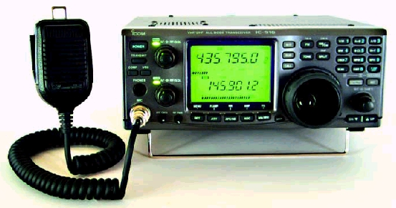
VHF / UHF Multimode Transceiver
VHF / UHF transceivers are available which will operate on FM as well as AM, SSB, and CW.
These transceivers are well suited for “weak-signal” communications work.

Slide 16
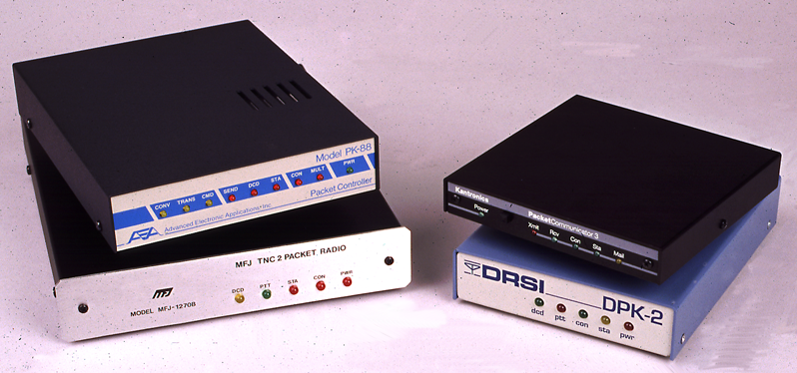
Data Communications - Packet
Packet uses a terminal node controller (TNC) to interface a computer and transceiver.
A TNC breaks the data to be transmitted into packets which includes error checking information.
On VHF an FM transceiver may be used for packet.
Since packet uses data carrier detect the receiver's squelch must be set to quiet the noise or the TNC may falsely detect a data carrier.
Packet
Computer
TNC
Transceiver

Slide 17
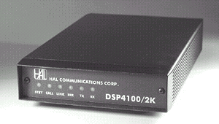
Data Communications - RTTY
A modem and teleprinter or computer are connected to a transceiver for RTTY operation.
An FM transmitter could be used for RTTY on the VHF / UHF bands.
RTTY transmits in a continuous stream and has no error checking.
RTTY
Computer or
Teleprinter
Modem
Transceiver

Slide 18
Station Accessories
A power supply converts 120 v AC to 12 v DC and is necessary to run a mobile transceiver in the house.
  A 12 volt battery may be substituted for a power supply.
A microphone must be connected to a transceiver for voice operation.
A telegraph key is needed for CW operation.
  An electronic keyer can be used to help form good morse code characters.
A dummy antenna (load) is used to adjust or troubleshoot a transmitter without transmitting a signal.
  If it is used with a 100-watt, SSB phone transmitter it should have a minimum rating of 100 watts continuous.

Slide 19
More Station Accessories
A duplexer is used to connect a dual-band transceiver with separate VHF & UHF outputs to a dual-band antenna.
  Most “dual-band” transceivers cover 2 meters and 70 cm.
A power amplifier may be useful to boost the low-power output from a hand-held transciever up to 100 watts.
An SWR meter may be connected between a transceiver and an antenna switch connected to serveral antennas to check & monitor the match to the antenna.

Slide 20
Station Layout
1
2
3
TRANSCEIVER
ANTENNA SWITCH
DUMMY ANTENNA
An antenna switch can be used to connect the transceiver to one of several antennas or to a dummy antenna.

Slide 21
Station Layout
1
2
3
TRANSCEIVER
SWR METER
ANTENNA TUNER
An Antenna Tuner connects directly to an antenna and allows an antenna to be used on a band it was not designed for.
An SWR Meter is used to measure the standing wave ratio and can be used to properly adjust an antenna tuner.

Slide 22
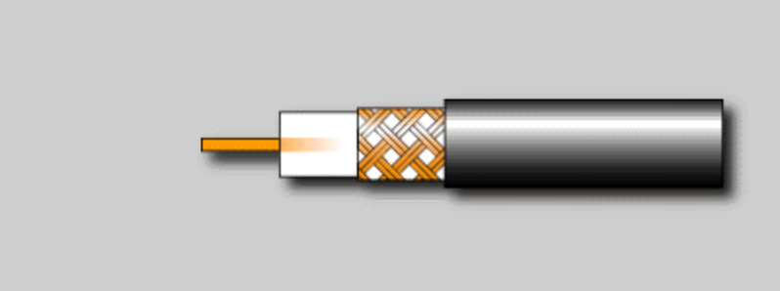
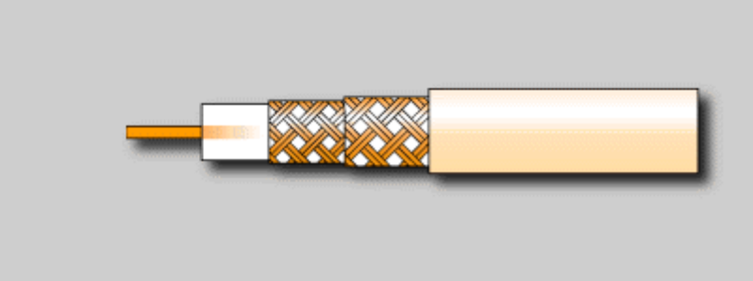
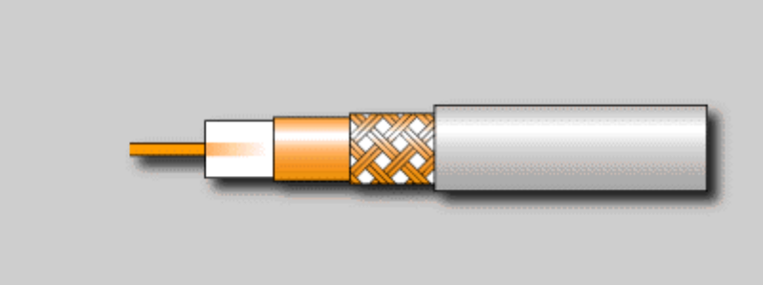
Coaxial Cable
Coaxial cable has a center wire inside an insulating material covered by a shield and an insulating cover.
Good quality coax should be used for a UHF antenna system to keep RF loss low.
Radio energy is converted to heat in a poor quality coaxial cable.
Coax is Unbalanced Feedline in that one conductor is connected to ground.

Slide 23
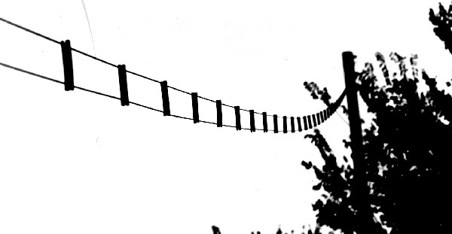
Parallel-Conductor Feed Line
Consists of two wires held apart by insulating material.
Parallel-conductor, open wire feed line will operate well even with high SWR and has less loss than coax.
Parallel-conductor feedline is balanced.

Slide 24
Concept of Standing Wave Ratio
If an antenna system matches the characteristic impedance of the transmitter all the power is radiated. Power travelling from the transmitter to the antenna is called Forward Power.
If an antenna system does not match the characteristic impedance of the transmitter, some of the power is reflected back to the transmitter. This is called Reflected Power.
At any point along the transmission line, the Forward Power and Reflected Power will add or subtract.
The Ratio of the Maximum Voltage to Minimum Voltage along the line is called Standing Wave Ratio (SWR).
1 Volt
0.5 Volt
R=1.5/0.5
= 3

Slide 25
Calculation of SWR
Visualize a coax with a slot in it so that a voltmeter probe can be inserted.
Slide the probe along the line and record the maximum and minimum voltage.
Calculate the ratio of maximum to minimum voltage.
V Max = 1.5
V Min = 0.5
SWR= V_{Max}/V_{Min}
= 1.5/0.5
= 3

Slide 26
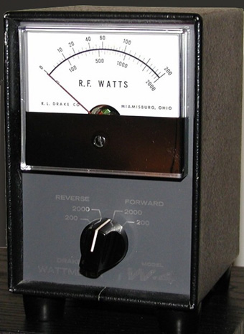
SWR Analysis
An SWR of 1:1 would indicate the impedance of the antenna and its transmission line are matched.
An SWR of 4:1 would indicate an impedance mismatch; something may be wrong with the antenna system.
If a directional RF wattmeter has a forward power reading of 90 watts and a reflected power reading of 10 watts the actual transmitted power would be 80 watts.
Most RF wattmeters operate with a line impedance of 50 ohms.

Slide 27
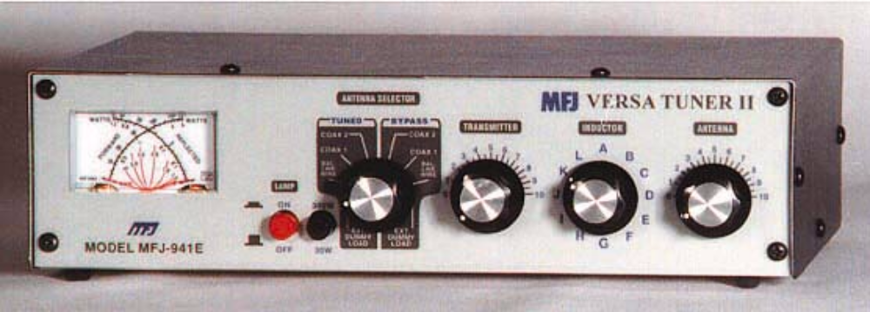
The Antenna Tuner
“Antenna Tuners” do not really tune antennas.
They provide an impedance match between the transmitter output impedance and the antenna system impedance.

Slide 28

The Balun
“Balun” means BALanced to Unbalanced.
The balun converts from balanced feed line to unbalanced feed lines.
A balun would be installed between the coax and the antenna to feed a dipole antenna with 50-ohm coax.

Slide 29
The 1/2 Wave Dipole
½ wavelength by formula
468
f (MHz)
Feed Point
Length of dipole in feet =
Coax
The physical length of a dipole and other antennas can be reduced without changing its resonant frequency by adding a loading coil.

Slide 30
The 1/2 Wave Dipole
Radiation pattern for a dipole antenna looking down from above the antenna.
If the ends of a ½ wave dipole antenna point east and west most of the radio energy is radiated north and south.

Slide 31
The 1/4 Wave Vertical
Feed Point
234
f (MHz)
¼ Wave
Length of vertical in feet =
¼ Wave Radials

Slide 32
½ Wave & ¼ Wave Excercise
A half-wave dipole for 147 MHz = ?? inches
A half-wave dipole for 223 MHz = ?? inches
A quarter-wave vertical for 146 MHz = ?? inches
A quarter-wave vertical for 440 MHz = ?? inches
37 inches
25 inches
19 inches
6 inches

Slide 33
The Yagi
1
Feed Point
2
3
Driven Element
The Driven Element is approximately ½ wavelength long.
The Boom length has the greatest effect on the gain of a Yagi.
Boom
Gain
Director
Reflector
Feedline

Slide 34
The Yagi
The yagi antenna focuses RF energy in one direction, giving the appearance of getting “free power.”
This free power is called Antenna Gain.
If an antenna has a gain of 3 dB the effective radiated power will double.
Many yagis are multiband antennas allowing them to operate on several bands with a single feed line.

Slide 35
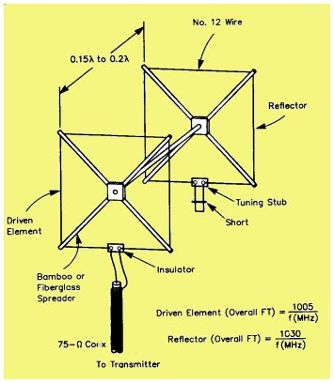
Cubical Quad Antenna
A cubical quad has two or more parallel four-sided wire loops, each approximately one-electrical wavelength long.

Slide 36
Radio Wave Polarization
With horizontal polarization the electric lines of force of a radio wave are parallel to the Earth's surface. Horizontal antennas produce horizontal polarization.
With vertical polarization the electric lines of force of a radio wave are perpendicular to the Earth's surface. Vertical antennas produce vertical polarization.
Most VHF and UHF repeater antennas use vertical polarization.
Most weak signal VHF / UHF SSB operation is done with horizontal polarization.
Most satellite operation uses circular polarization.

Slide 37
VHF / UHF Antenna Considerations
Most hand-held transceivers come with a “rubber duck” antenna which is much less efficient than a quarter-wavelength telescopic antenna.
The operation of a hand-held transceiver in a vehicle will be greatly improved by using an external antenna on the vehicle roof.

Slide 38
Ammeter
An ammeter measures current.
An ammeter is connected in series with the circuit under test.
Ammeter
Power Supply
Transceiver

Slide 39
Voltmeter
A voltmeter is used to measure electromotive force.
A voltmeter is connected in parallel with the circuit under test.
When you switch a voltmeter to a higher range resistance is added in series with the meter.
Voltmeter
Power Supply
Transceiver

Slide 40
Ohmmeter
An ohmmeter is used to measure DC resistance.
Ohmmeter

Slide 41
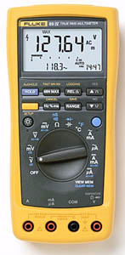
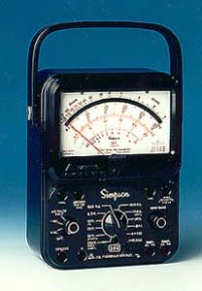
Multimeter
Multimeters will measure Voltage, Current and Resistance.
Be sure it is set properly to read what is being measured.
If it is set to the ohms setting and voltage is measured the meter could be damaged!

Slide 42
Meter Excercise
What circuit quantity would meter A indicate?
+
Meter B
R
Battery voltage
Meter A
What circuit quantity would meter B indicate?
The current flowing through the resistor

Slide 43
Power
Power is measured in Watts
+
Meter B
R
W = E x I
Meter A
Ohms law states E= I x R
Substituting I x R for E in the power equation gives:
W = I x R x I = R x 2 x I = R x I²
So, for this circuit, the power consumed in the resistor can be calculated by multiplying the value of the resistor times the square of the reading of Meter B.

Slide 44
Soldering Safety
When using a soldering iron or gun keep in mind the following safety considerations:
  A soldering iron gets very hot, make sure no one touches it for at least 10 min after turning it off.
  Wear safety glasses, occasionally molten solder will splash.
  Solder in a well ventilated area. The fumes can be hazardous.

Slide 45
Basic Troubleshooting
If a rig works in the car but not in the house the first thing to check is the power supply.
If a mobile transceiver does not power up check the 12 volt fuses.
If it is suspected the supply voltage to a rig is low, check the voltage with a voltmeter at the 12 volt plug on the rig rather than at the power supply or battery.

Slide 46
More Basic Troubleshooting
If AC hum is reported on a CW transmitter's RF signal additional filtering of the power supply may be required.
Stray noise and RF pick-up may be reduced by providing adequate DC source supply filtering for a mobile transceiver.
A signal generator produces a stable, low-level signal that can be set to a specific frequency and may be useful for checking a receiver.

Slide 47
Homework
Study Subelement T8 of the question pool.
  Read the Question and the Answer Three Times.
Read Chapter 8 in “Now You're Talking”.

