Slide 1


Technician Licensing Class
Lesson 5
presented by the
Midland Amateur Radio Club
Midland, Texas

Slide 2
Quiz
Subelement T8

Slide 3
Special Operations
Subelement T9

Slide 4
Repeaters
A repeater is an amateur station that simultaneously receives a signal on one frequency and retransmits it on a different frequency.
Why? A powerful repeater transmitter located at altitude greatly increases the usable range of mobile and hand-held stations.
A repeater that retransmits the signal on a different band is called a “crossband repeater”.

Slide 5
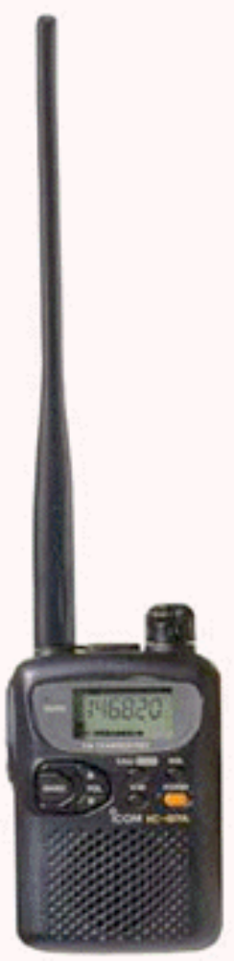
Repeaters
In order to use a repeater, you must first know the repeater’s input (or output) frequency and offset.
The offset is the difference in the repeater’s receive and transmit frequencies.
On 2 meters the usual offset is 600 KHz and on 70 cm it is 5.0 MHz.
Most modern radios will set the offset for you automatically.

Slide 6
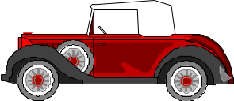
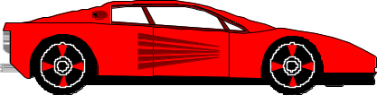
Repeater Operation
Output Freq
147.30 MHz
Input Freq
147.90 MHz
Offset
+ 600 kHz
60 miles

Slide 7
Repeater Access
Continuous Tone Coded Squelch System (CTCSS) tones are sub-audible tones added to an FM carrier which may cause a receiver to accept the signal.
Some repeater systems require CTCSS tones to access.
If someone tells you a “tone” is needed to access a repeater then you must use a CTCSS tone to operate it.

Slide 8
Repeater Operation
A repeater has a time-out timer to limit the amount of time the repeater can transmit continuously.
At the end of each transmission through a repeater, you will typically hear a “courtesy tone” (a short beep, or series of beeps).
When you hear the courtesy tone the time-out timer has been reset and you can begin your transmission.
A repeater may identify itself with automatic Morse code tones or a voice announcement.

Slide 9
Using a Repeater
To determine if a repeater is already being used ask if the frequency is in use, then give your call sign. (In reality, no one does this.)
To break into a conversation simply give your call sign during a break between transmissions.
Pause briefly between transmissions to listen for anyone wanting to break in.
Typically, third-party communications nets are discouraged during commuting hours.

Slide 10
Using a Repeater
Keep transmissions brief in case someone with an emergency needs to use the repeater.
Support the repeater owner with a donation or club membership.
If you would like to use a “closed” repeater system contact the control operator and ask to join.

Slide 11
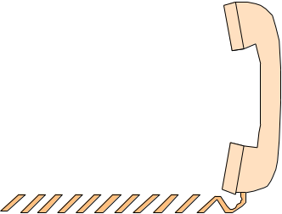
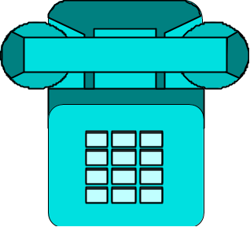
Autopatch
Amateurs can use a repeater’s “autopatch” to connect to the public telephone network via radio.
However, conversations are not private but can be heard by anyone monitoring the repeater.

Slide 12
Repeater Coordination
When a new repeater is planned to be installed in an area the frequency of the new repeater must be assigned a frequency by a “frequency coordinator”.
When two coordinated repeaters interfere with one another it is up to both repeater licensees to resolve the interference.

Slide 13
Simplex Operation
Simplex operation is simply transmitting & receiving on the same frequency.
Simplex operation is encouraged when two stations are close enough to communicate without using a repeater.
You can check if simplex operation is possible by listening on the repeater's input frequency.

Slide 14

Satellites
Keplerian elements are a set of mathematical parameters used to calculate a satellite's position.
A satellite's perigee is it's closest approach to the Earth's center.
A satellite's apogee is it's farthest distance from the Earth's center.
Apogee
Perigee

Slide 15
Satellites
Most satellites use VHF & UHF frequencies because they pass easily through the ionsphere.
When communicating through a satellite the receiving frequency must be adjusted up or down due to the Doppler effect.
Any class of license may be the control operator of a station communicating through a satellite.
The International Space Station is typically in range to communicate only 4 to 6 minutes per pass.

Slide 16
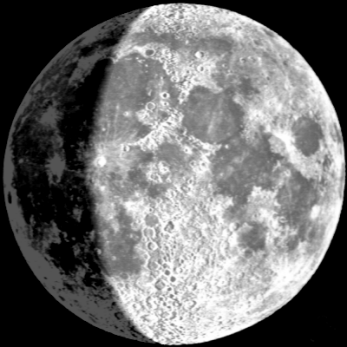
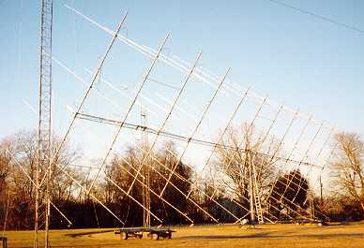
EME (Moonbounce)
Earth-Moon-Earth communication is accomplished by bouncing VHF or UHF signals off the moon.
CW is a good mode for EME.
High gain antennas are needed for EME.
A ground-plane antenna would NOT be a good EME antenna.

Slide 17
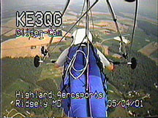
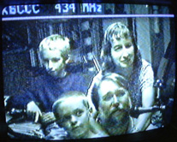
Image - ATV
Amateur TV (ATV) is just like regular TV and is typically transmitted on the UHF & microwave bands.
A cable ready TV can be used to monitor ATV on the 70 cm band.

Slide 18
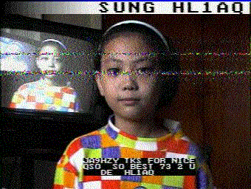
Image - SSTV
Slow Scan TV (SSTV) is typically used on 20m.
SSTV could be transmitted through a 2 meter repeater if the repeater control operator authorizes it.
A sample SSTV transmission.

Slide 19
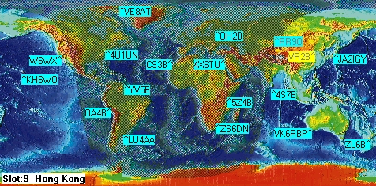
Beacons
A beacon is a station that tranmits for the purpose of propagation observations.

Slide 20
More About Beacons
Automatically controlled beacon stations are allowed in certain band segments.
The maximum power of a beacon must not exceed 100 watts.
Beacons are allowed one-way transmissions.

Slide 21
Telecommand
Telecommand is a one-way transmission to control a device at a distance.
For telecommand to be legal:
  The station must have a wireline or radio control link
  A copy of the station license must be posted
  The station must be protected so unauthorized transmissions cannot be made
As a minimum, a model aircraft control transmitter must have the station call sign and licensee's name and address.

Slide 22
Electrical, Antenna Structure, & RF Safety Practices
Subelement T0

Slide 23
Safety
Amateur Radio is a relatively safe hobby.
There are only a few ways to get hurt or killed being a ham radio operator:
  Electrocute yourself.
  Fall off a tower, or the inverse, have someone/something fall on you from a tower.
  Slowly cook yourself with RF energy.

Slide 24
It Just Kills Me...
People have been killed by as little as 30 Volts.
As little as 1/10 of an amp can be fatal.
The heart can be fatally affected by a very small amount of electric current.
The path electric current takes across the body is important. Therefore, always keep one hand in your pocket when working near dangerous voltages.

Slide 25
Ground Everything
For best protection from electrical shock all equipment should be connected to a common ground.

Slide 26
Open & Short Circuits
+
-
Normal Circuit
Open Circuit
Draws no current
+
-
Short Circuit
Draws high current
+
-

Slide 27
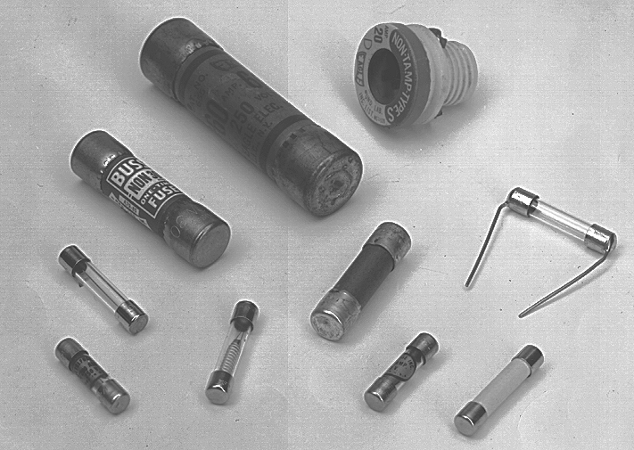
The Fuse
A fuse or circuit breaker should always be added in series with home built equipment that is powered from 110 volt AC lines.
In a 12 volt DC system fuses should be located at the voltage source.
When a fuse blows an open circuit is created.
Never replace a blown fuse with a higher amperage rated fuse.

Slide 28
High Voltage Safety
The power supply for a transceiver or power amplifier should be controlled by a safety interlock switch.
Make sure everyone knows where the main power switch is located in case of an emergency.
Never touch the ungrounded side of a capacitor as they can store a charge for a long time.

Slide 29
Three Wire Plug
In a three wire AC electrical line:
Black is HOT
White is NEUTRAL
Green is Chasis Ground

Slide 30
Tower Safety
Before climbing and working on a tower:
  Tell someone you will be up on the tower
  Inspect the tower for cracks & loose bolts and obstructions
  Inspect the guy wires & guy anchors
  Take a variety of tools to minimize trips

Slide 31
More Tower Safety
Don’t climb towers without a safety belt and safety glasses.
  If using a leather climbing belt keep in mind the leather could be old & brittle and could break unexpectedly
Don’t do tower work without a ground crew.
If you’re working under the tower, wear a hard hat.

Slide 32
Antenna Safety
Keep your antenna and feedline from overhead power lines.
When using a bow & arrow or slingshot to shoot an antenna support over a tree:
  Ensure the bow & arrow or slingshot are in good condition
  Ensure the flight path is clear in case the line breaks
  Ensure the line is strong enough to handle the shock of the arrow or weight.

Slide 33
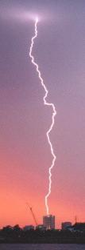
Lightning
To protect antennas from lightning damage ground them when not in use.
To protect station equipment from lightning disconnect all equipment from AC power lines and antennas.
GET OFF THE AIR DURING SEVERE STORMS!!

Slide 34
RF Exposure Safety

Slide 35
Two Types of Radiation
Ionizing
  Can knock electrons loose from their atoms forming positive & negative ions
  Gamma rays, X-rays, and ultraviolet rays
Non-ionizing
  Radio frequency waves
  Can cause heating of biological tissue
  If sufficient energy is present, can cause burns

Slide 36
RF and the Human Body
Specific Absorption Rate (SAR) is the rate RF energy is absorbed into the human body.
  Maximum Permissible Exposure (MPE) limits are based on the whole body SAR.
The human body's ability to absorb RF energy varies with frequency.
Exposure of the human body to high levels of RF energy can cause heating of body tissue.
Exposure of the eye to RF can expose the eye to more than the MPE limit and cause heating, which can result in the formation of cataracts.

Slide 37
FCC RF Exposure Regulations
Can be found in FCC Part 1 and Office of Engineering and Technology (OET) Bulletin 65
Established to ensure a safe operating environment for amateurs, their families, and neighbors
Establish and specify maximum exposure limits, not emission limits.
Specifies Maximum Permissible Exposure (MPE) limits for all frequencies between 300 kHz and 100 GHz.

Slide 38
FCC RF Exposure Regulations
Most stringent for frequencies between 30 MHz and 300 Mhz.
Does not require retention of records of RF radiation exposure evaluation.
Does not establish mandatory procedures for evaluating compliance with RF exposure limits, only that the station does not exceed the maximum permissible exposure limits.
“Portable” devices are those designed so that the antenna is within 20 cm of the body of the user.

Slide 39
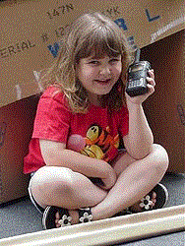
Who is Exempt?
The RF safety regulations do NOT apply to:
  Any station that produces less than 50 watts PEP
  Mobile equipment
  Hand-held radios

Slide 40
Mobile & Hand-held Considerations
Even though hand-held radios are exempt from RF exposure limits, minimum power should be used with a hand-held to minimize RF exposure to the operator's head.
A mobile transceiver with roof mounted antenna would have better shielding for the vehicle occupants than using a hand-held transceiver in a vehicle.

Slide 41
Controlled and Uncontrolled Environments
Controlled Environments
  Persons here are aware of RF risks and can take steps to minimize RF exposure.
  The amateur operator's household and property
Uncontrolled Environments
  Persons here are generally not aware of RF risks.
  Your neighbor's household & property and sidewalk areas around your home.
  More stringent than the contolled environment limits.

Slide 42
Exposure Averaging Times
Controlled Environments
  The exposure averaging time is
6 Minutes
Uncontrolled Environments
  The exposure averaging time is
  30 Minutes

Slide 43
Measurement Units
The power density of a radiated RF signal is measured in “milliwatts per square centimeter (mW/cm²).”
The RF electric field strength is measured in “volts per meter (V/m).”

Slide 44
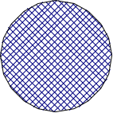
Near Field & Far Field
Reactive Field
In the “far field” the power density is proportional to the inverse of the square of the distance.
  Doubling the distance to the antenna reduces the power density to ¼ as strong.
In the “near field” the signal strength variance depends on the type of antenna.
Wavelength & physical antenna size determine the boundary between the near & far fields.
Dipole
Far Radiating
Field
Near Radiating Field
RF exposure effects are the most difficult to evaluate in the near field.

Slide 45
Determining RF Power Densities
Use one or more methods in the amateur supplement to FCC OET Bulletin 65
  Direct measurement of the RF fields
    Requires calibrated field strength meter
  Calculate the RF fields with a computer model
  Use the charts published by the FCC in OET Bulletin 65

Slide 46
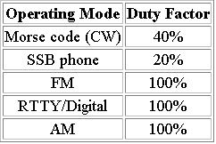
RF Safety & Duty Cycle
Duty cycle takes into account the amount of time a transmitter is operating at full power during a transmission.
The lower the duty cycle, the shorter the compliance distance.
The higher the duty cycle, the longer the compliance distance.
Lower duty cycles expose people to lower radio-frequency radiation.

Slide 47
RF Exposure Limit Factors
Duty cycle
Frequency & power level
Antenna height & distance to a person
Antenna radiation pattern
Any of these can be changed to prevent exposure to RF radiation in excess of FCC specified limits.

Slide 48
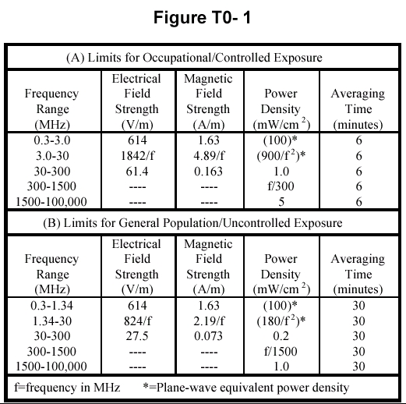
Figure T0-1
Which equation should be used to calculate the maximum permissible exposure (MPE) on the Technician HF bands for a controlled RF radiation exposure environment?
Maximum permissible power density equals 900 divided by the square of the frequency, in MHz.

Slide 49
Figure T0-1
What is the formula for calculating the maximum permissible exposure (MPE) limit for uncontrolled environments on the 2-meter (146) MHz band?
There is no formula, MPE is a fixed power density of 0.2 milliwatt per square centimeter.

Slide 50
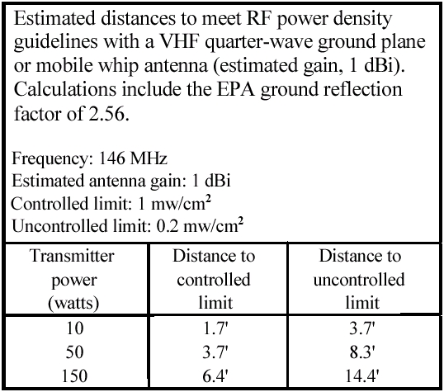
Figure T0-2
What is the minimum safe distance for a controlled RF radiation environment from a station using a 146 Mhz ¼-wave whip at 10 watts?

Slide 51
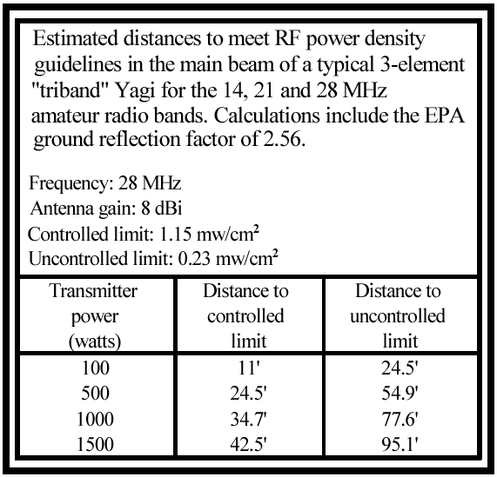
Figure T0-2
What is the minimum safe distance for an uncontrolled RF radiation environment from a station using a 3-element “triband” Yagi antenna on 28 MHz at 100 watts?

Slide 52
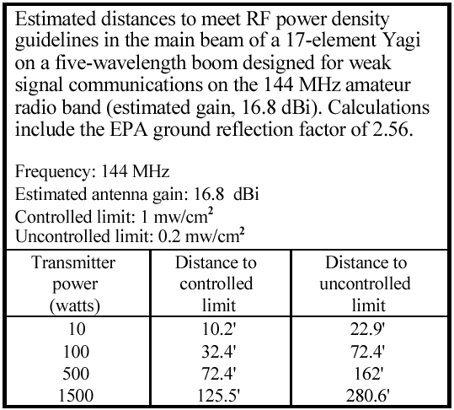
Figure T0-2
What is the minimum safe distance for a controlled RF radiation environment from a station using a 17 element Yagi on a five-wavelength boom on 144 Mhz at 100 watts?

Slide 53
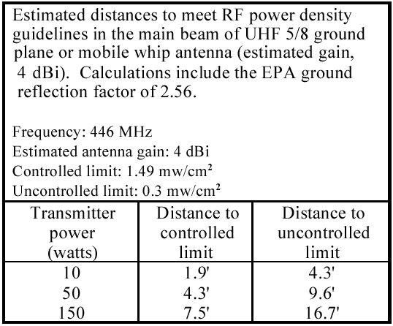
Figure T0-2
What is the minimum safe distance for an uncontrolled RF radiation environment from a station using a 446 MHz 5/8-wave ground plane vertical antenna at 10 watts?

Slide 54
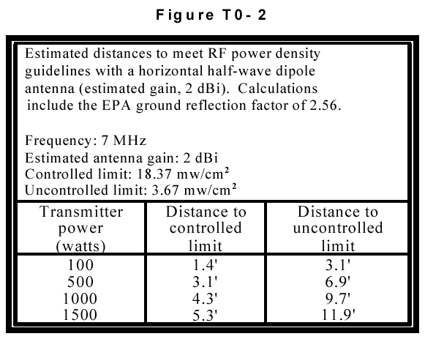
Figure T0-2
What is the minimum safe distance for a controlled RF radiation environment from a station using a ½ wave dipole on 7 Mhz at 100 watts PEP?

Slide 55
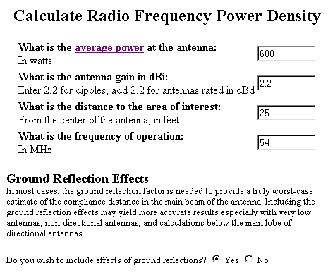
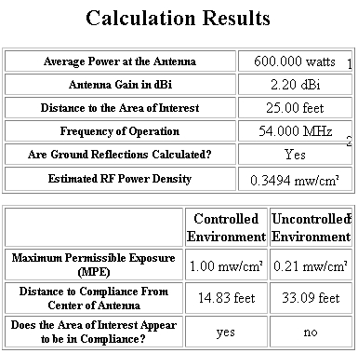
http://n5xu.ae.utexas.edu/rfsafety/
When using a computer to model RF fields the ground interactions must be taken into account.

Slide 56
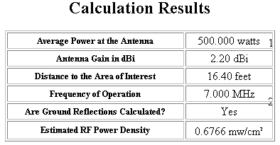
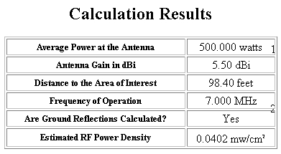
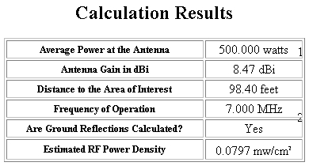

Antenna & Height Comparison
Dipole
Loop
(5m)
(30m)
Quad
Yagi
(30m)
(30m)

Slide 57
RF Safety for Dummies
Don't stand near or touch a transmitting antenna when it is being fed with 1500 watts of RF energy!

Slide 58
Homework
Study Subelements T9 & T10 of the question pool.
  Read the Question and the Answer Three Times.
Read Chapters 9 & 10 in “Now You're Talking”.
Read the handout “Additional Information for Amateurs Completing Form 605”.

